Slide 1

Variable Names in Compiler and Interpreter Methods
YeongWon Jeon
School of Electronic and Electrical Engineering, KNU, KOREA
2024.06.28

Slide 2
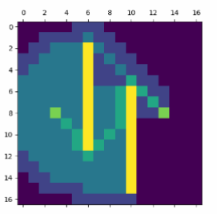
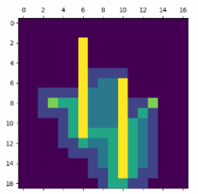
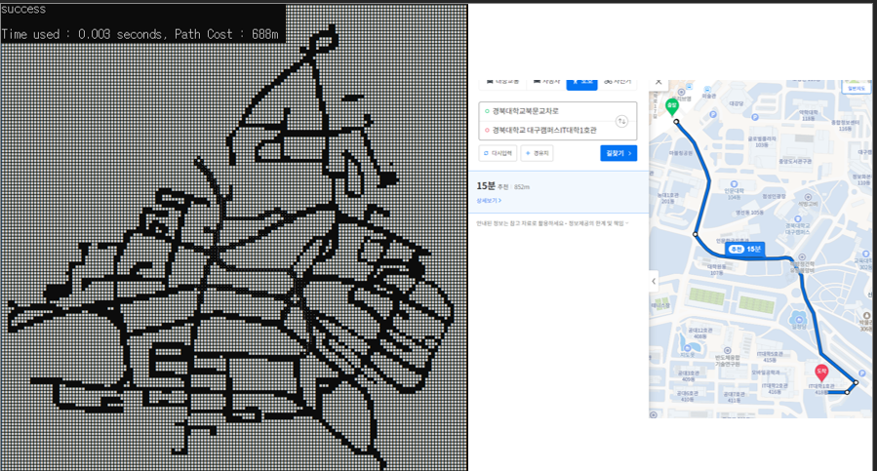
Adaptive A* algorithm

Slide 3
Compiler and Interpreter Methods

